Slide 1


Subhadip Samanta
IIFT Delhi
4.5 4.7

Slide 2





ABOUT BEWAKOOF:
Founded in 2012, Bewakoof is a lifestyle fashion brand that makes creative, distinctive fashion for the trendy, contemporary Indian.
Bewakoof was created on the principle of creating impact through innovation, honesty and
BEWAKOOF has
raised a total of ₹805.6M in funding
over 3 rounds
thoughtfulness.
Bewakoof, that kick started in an IIT hostel room is today a pan India brand that sells 1 lakh products per month and ships to more than 19000 pin codes
PROBLEM STATEMENT:
With a team of 400 members,
and 8 Million+ products sold till date
4.7
Apple Store
Work towards building a USP for BEWAKOOF, Come up with changes in the Product
OUR GOAL:
To achieve User Retention, User Engagement, and User Retention for the App.

Slide 3



ROADMAP:
USER
PERSONA
JOURNEY
MAPPING
PAIN
POINTS
SOLUTIONS
ANALYSIS
METRICS
IMPACTED
USER PERSONAS:
31 years old lives in Delhi.
After escaping from his daily life schedule. Gaurav loves partying and clubbing.
Gaurav is confused that whether the online ordered apparel combo looks good or not?
26 years old lives in Jaipur.
Highly Occupied by her 9-5 Job, loves shopping in her free time.
But is always anxious about the fact that the apparel she’s looking would fit her or not?
19 year old lives in Kota
Preparing for JEE(Mains and Advanced), apart from studying he is obsessed with superheroes.
Therefore, Looks for deals on Marvel and DC merchandise.
Gaurav, Jr. Manager
Neha, Receptionist
Manas, Student

Slide 4
USER’S JOURNEY:
SEARCHES THE PRODUCT
READ THE REVIEWS
OPEN’S BEWAKOOF APP
BROWSES FROM AVAILABLE COLOURS
ORDER PLACEMENT
WANTS TO BUY THE PRODUCT
SELECTS SIZE
SELECTS FROM HOMEPAGE
READ THE REVIEWS
“Will the size even fit me?”
As I am gaining weight nowadays.
“Will this T-shirt colour matches with my trouser?” I have already selected the
trouser and it’s in the wish list
Finally the weekend is approaching, and there is this huge party.
Let’s scroll through the trending designs and make the Dashing outfit for the party
Let’s open the BEWAKOOF
app.
I’m Free from my hectic 9-5 job.
Let’s browse, what are the hot deals and designs from BEWAKOOF
So, let’s open the BEWAKOOF app.
Gaurav
Neha

Slide 5
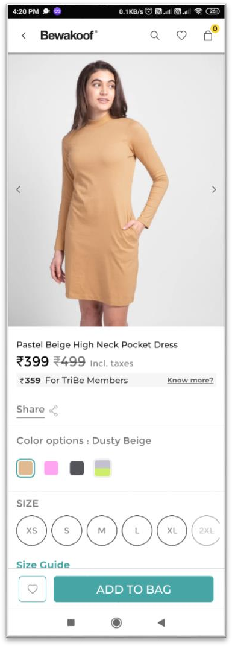
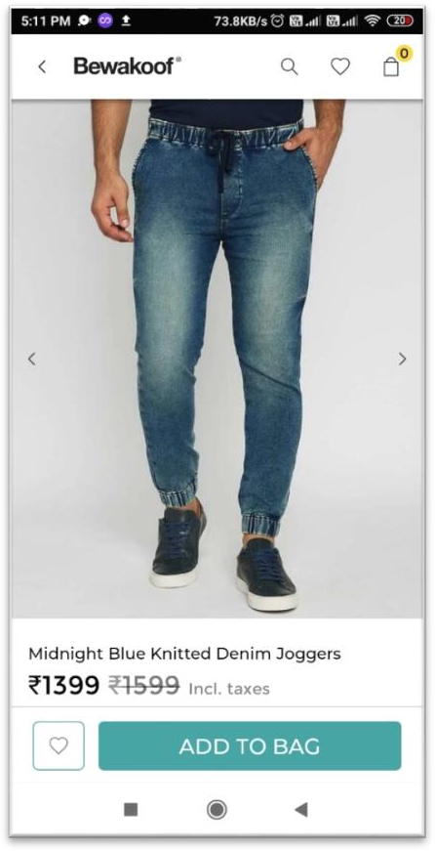
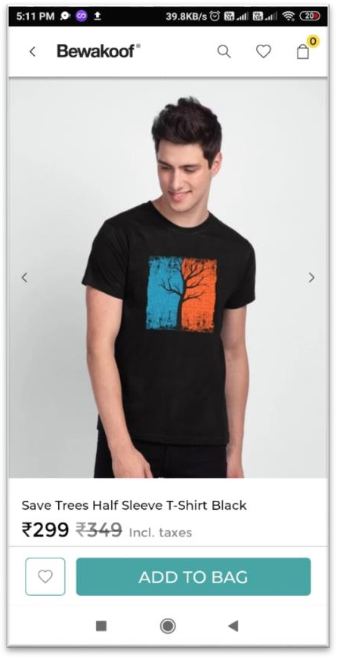

PAIN POINTS:
1.
2.
When I select the product finally, I a still insecure about the fact that will it fit my body type or not, I can return the product but it takes a Long time in that Process.
When I select a particular outfit I am confused that how the overall ensemble outfit will look? I can order both the things(i.e T-shirt and Lower) together but if I don’t like the combination it would take long time in the return process
Neha
The user can only select one Product at a time and cannot see that how does the combination of the products would look as the other product will be in the wish list.
The Catalogue just gives the information about available sizes, but does not tell anything about user body types
Gaurav

Slide 6
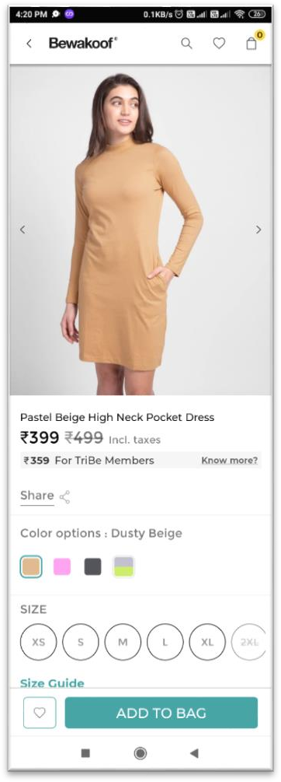
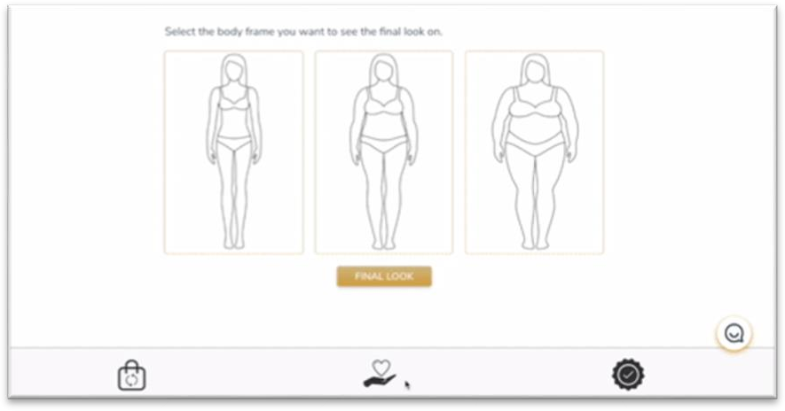
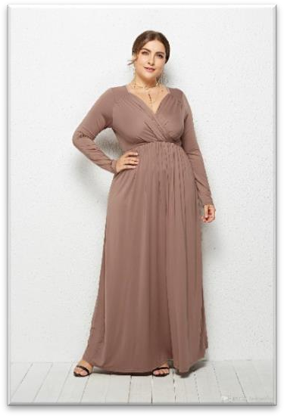



SOLUTION 1:BODY TYPES
Features:
Enables the User to see how the apparel would look when tried by different body types.
Select the body frame you want to see the final look on
Insights:
According to Digital Commerce 360, poor fit/ incorrect sizing is the most common reason for returning an online order
User can now see that how the dress would look when put on by different body types
Tentative*
Body Types
Value proposition to BEWAKOOF:
Value proposition to User:
Now, I can see how the Dress looks on me! This saved my time.
Increased Engagement.
Increased Acquisition.
Increased Retention Rate.
Users can now see that how that particular product would look on them when put on.
This clears the uneasiness faced by Users thinking about the fitting of Product
METRICS:
Neha
DAU/MAU
Number of Orders placed/User

Slide 7
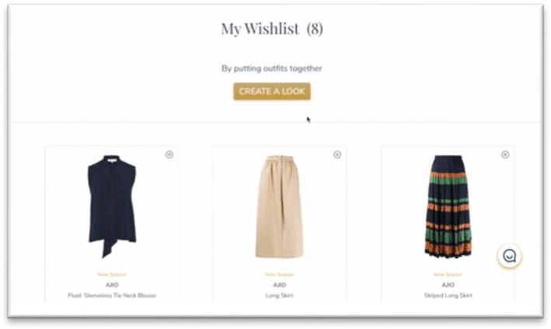

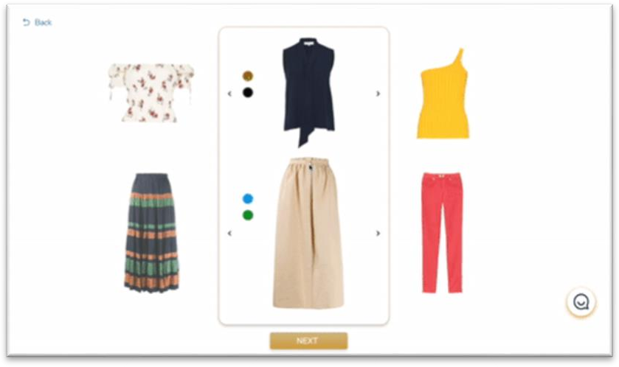
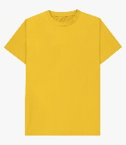

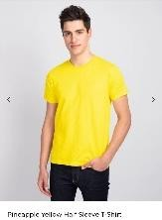
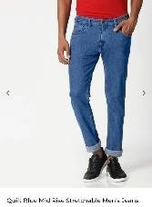
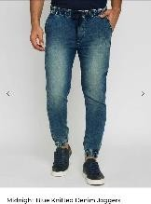
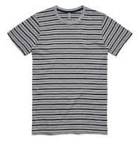
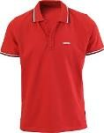
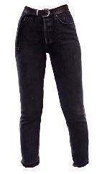
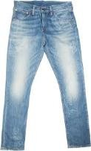
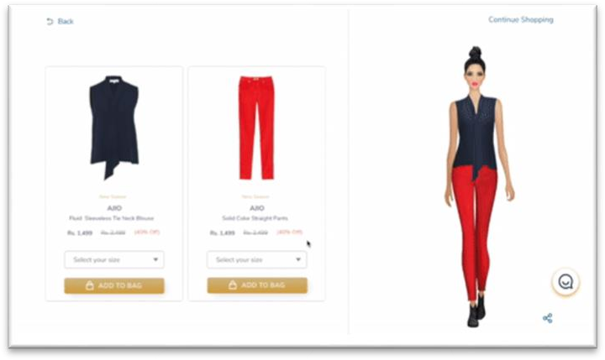
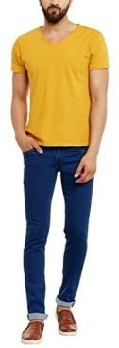
SOLUTION 2:CREATE YOUR LOOK
Features:
Enables the User to personalise their Looks by combining different apparels and suggest them trending looks with the help of integrated AI.
Insights:
Value proposition to User:
A study by Deloitte suggests that, on average, in different retail sectors, 36% of consumers would consider buying customised products or services
1 in 5 of these consumers would be willing to pay 20% more for a personalised or exclusive product!
Users can now customise the products and check
how they will look when put on together.
Users can also select from Ai based recommendations of trending product customisations.
When users get their personalised product, they are
more likely to feel satisfied with it
My Wish list
Value proposition to BEWAKOOF:
Increased Engagement.
Increased Acquisition.
Increased Retention Rate.
Increased Loyalty
Increased Revenue
METRICS:
Based on the selections the App shows the final Customized design which can be shared as well on Social Media
Tentative AI Recommendations based on Wish lists
DAU/MAU
Number of Orders placed/User
Retention rate

Slide 8




QUALITATIVE SOLUTION ANALYSIS:
USER | METRICS TO OPTIMIZE | BODY TYPES | CREATE YOUR LOOK
 | UTILITY INCREASE FOR THE APP
 | USER EXPERIENCE
 | IMPLEMENTATION EASE
COMPANY | REVENUE PROSPECT
 | APP REVIEWS
To find the Best Solution, we have to know, Best for whom? The stakeholders are the company and the users. We evaluate solution on what factors are crucial for both
Relevant
Relevancy:
BODY TYPES: 6
CREATE YOUR LOOK: 7
So Create your look is the solution we should implement in priority to achieve our goal

Slide 9
MEASURING THE SUCCESS OF SOLUTIONS:
We will use commonly used metrics from frameworks used in the industry like AARRR and HEART that are
relevant to the solution. The following are reporting metrics .
METRIC HEART | GOALS | SIGNALS | METRICS
HAPPINESS | User Satisfaction | User reviews and Ratings from Customer support | NPS, Average App rating
ENGAGEMENT | User Personalising Apparels | Total number of orders and Time spent on the App | Total Revenue per user, Average orders per Month
ADOPTION | User Onboarding | Number of App downloads, New Users, FTUE | Average wish lists personalised, Number of reviews of Users
RETENTION | User Loyalty | Recurring Users | Monthly Retention Rate, Number of items Sold by same Reseller
TASK SUCCESS | User Goal Completion | User Analytics and User Studies | Number of items Sold, Number of Points Earned

Slide 10
METRICS WRONGLY IMPACTED:
POSSIBLE REASONS FOR FAILURE
Bounce rate must be analysed per page/feature-wise, looking at user journeys, to understand if a particular feature is experiencing maximum bounce rate, it should be improved accordingly.
1. Product Match in Customise look needs to have a high accuracy as user sentiments are affected. The implementation cost of a high accuracy Algorithm(>99%) is a barrier for an efficient implementation.
Churn Rate : If churn rate is going up, BEWAKOOF must analyse what kind of users they are losing. As per their past trends, the users must be offered customized deals/discounts through mails or notifications (in case the app is still installed), to bring them back
Monthly Revenue : If the Cumulative Revenue is going down, per feature revenue must be considered to see which feature is doing well and which is not.
2. In the case BEWAKOOF uses an external API for Product Recommendations, it’s added to cost incurred per customer.
3. Inefficient implementation of the feature could cause distrust in users about how a profile is verified, App reviews/ratings and Weekly Active users can be tracked.
LTV:CAC Ratio : This is to understand how much company is spending to maximise growth and revenue, on acquiring customer. If it’s low, company needs to evaluate to cut down costs on customer acquisition

Slide 11
THANK YOU!

